Slide 1

Genetic Algorithms and Modularity
biological data science
spring 2019

Slide 2
Genetic Algorithms (GAs)
Elements / chromosomes / individuals can be modeled in many ways
Not necessarily linear array
Could use a matrix, etc. (Ken is using linked-list of linked-lists)
Operators can be diverse
Customize for the specific domain
Can run many different populations (islands)
Optionally have individuals migrate to other islands
Possible to run in parallel

Slide 3
Genetic Algorithms
Capable of traversing rugged and vast solution spaces
Allows the use of alternative fitness functions (objectives)

Slide 4
Modularity
Developed by Newman and Girvan in 2003
A function to capture quality of clustering
Compares the densities of edges within clusters with expected numbers for random graph with same degrees for the nodes
Ranges from -1 to 1
Higher values indicate higher quality of clustering

Slide 5
Modularity
No sphericity assumption
No linear ordering assumption

Slide 6
Modularity
Exhibits ‘resolution limit’
Penalizes small-scale clusters
Biased against singletons and other small clusters

Slide 7
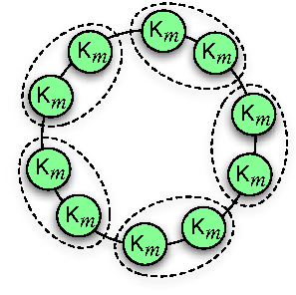
Resolution Limit
Each cluster, K_m, is a clique with m nodes
For an adequately large network, cliques will be merged together

Slide 9
Red edges are noise

Slide 10
Results when modularity is maximized

